Slide 1


Tools
Eco-entrepreneurship & Circular Economy: On the Path to Sustainable Change

Slide 2

Researching and defining of ecological issues in different natural environments
TOOL 1
Format: Teamwork activity
Duration: 180 minutes
Number of Participants: Maximum 20 participants divided into teams of five
Goal of the Tool: To create a teamwork activity that aims to develop statistical and presentation skills of participants by creating and conducting of survey, processing and presenting of survey results, including defining main ecological issues and developing eco-entrepreneurship ideas which should solve defined issues.
The activity objectives are:
  To promote survey conducting as statistical tool for defining ecological issues in different types of natural environment;
  To encourage developing of eco-entrepreneurship ideas regarding to survey results;
  To promote information processing by using visualization as a driver for raising ecological awareness and developing of eco-entrepreneurship ideas;
  To raise awareness of realistic ecological conditions in different types of natural environment.

Slide 3

Instructions: Maximum 20 participants have to be divided into teams of five. Conference room has to be equipped by one projector and facilitator’s laptop and four tables (for 5 participants each). Four tables have to be equipped whether with a laptop, spreadsheet software or Microsoft Excel, Google form, Internet access, or paper and colored pens. The duration of applying of this tool would be between 120 and 150 minutes divided on following sections:
Data creation: Facilitator would give, as topic, to each team different type of natural environment to research about ecological issues by which are those natural environments faced. Each team should create survey on Google form and conducted it to minimum 15 potential respondents online, in order to collect most relevant data. Survey should contain questions for only need-to-know information such as basic personal data of respondents, characteristics of certain natural environment- it’s benefits and deficiency, pollution level and it’s causes, possible solutions, rate of employment, education level and willingness of respondents to engage in development of ideas for eco-entrepreneurship. This task should last up to 80 minutes.
Presentation preparing: Each team should collect and visualize the information received from survey. Data analysis should be done in Microsoft Excel or Google Spreadsheet (or in any other software tool, or just colored drawings on a piece of paper) using graphs and prepare for presentation with conclusions and recommendations of possible solutions of ecological issues focusing on developing of eco-entrepreneurship ideas. This task should last up to 60 minutes.
Peer Assessment: Each team should present their report to the other groups. Next, each team's members should grade other team's reports using a 3-point grade scale (1-3). Grades should be communicated to the facilitator on a piece of paper, who would announce the winning team and give an award (optional). This task should last up to 30 minutes.

Slide 4

Feedback and reflection
What are the key takeaways from this activity?

Slide 5
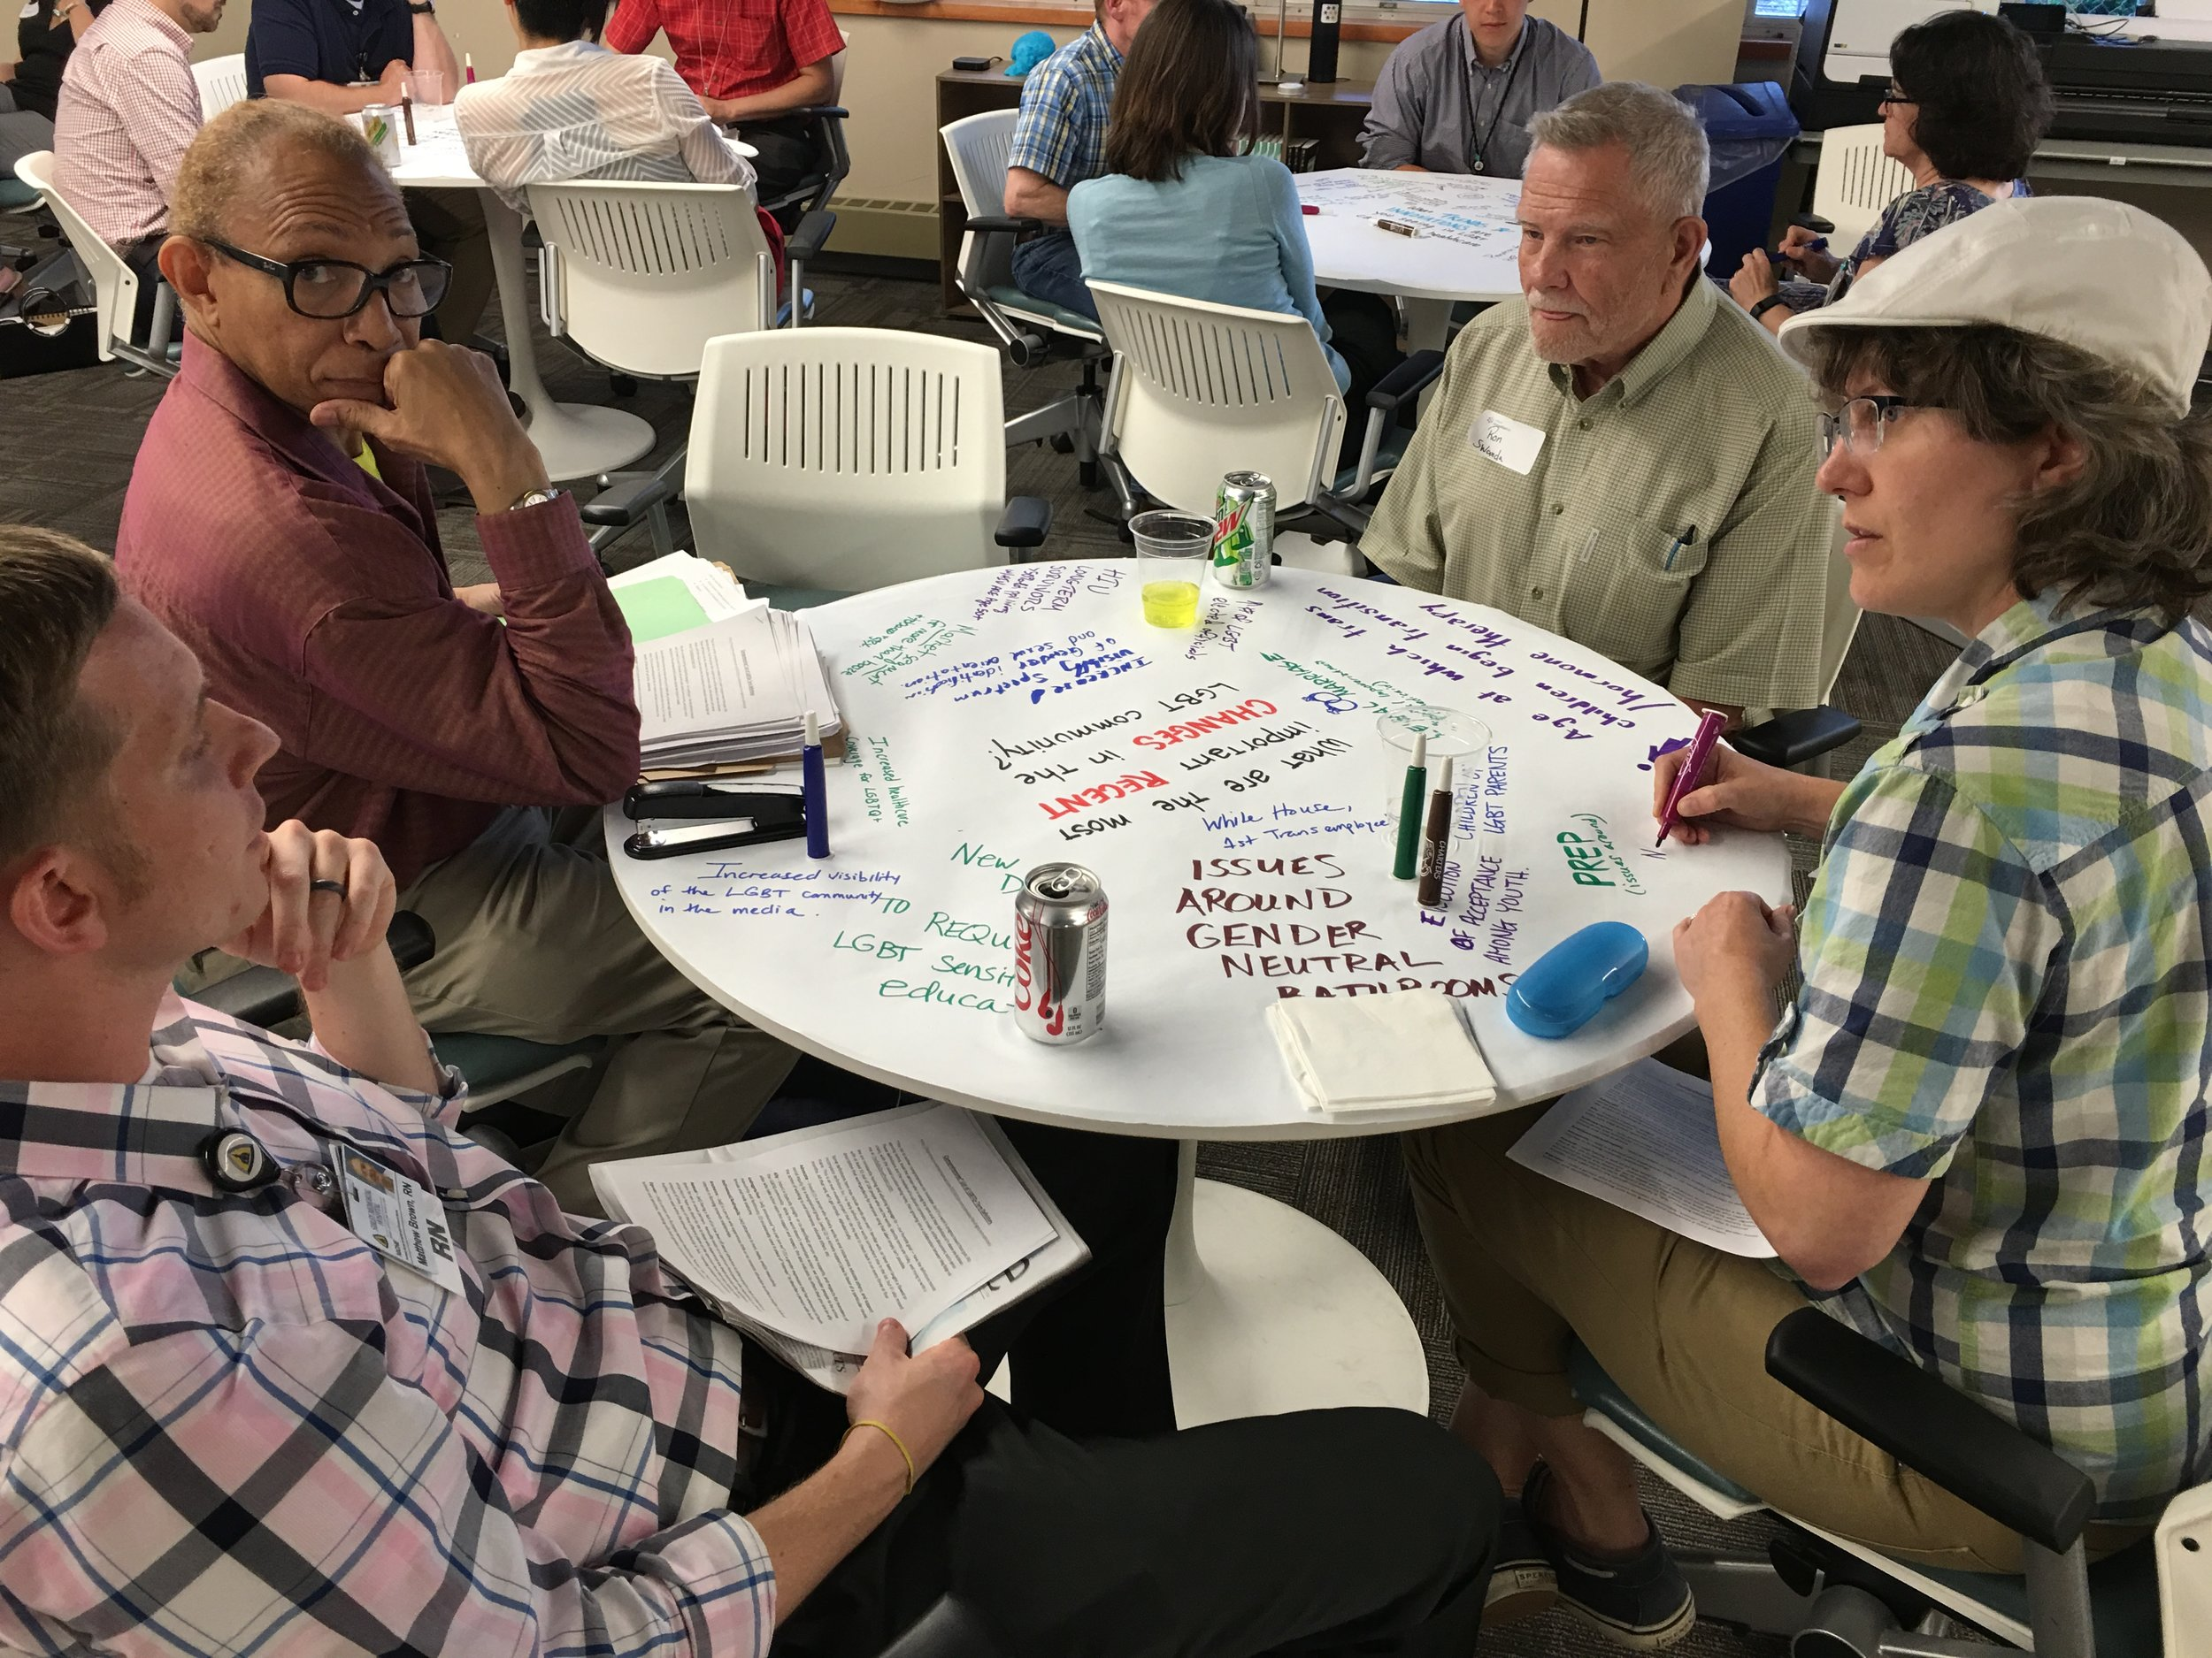
World Café workshop on eco-entrepreneurship
TOOL 2
Format: World Café
Name of the tool: World Café workshop on eco-entrepreneurship
Time: 80 minutes
Number of Participants: 20 participants
Goal of the Tool: The goals are to learn how to successfully, shortly present eco-entrepreneurship idea within a larger group and create a discussion where creativity and innovation are applied to developing an eco-entrepreneurship idea. The focus of this dynamic is on researching and innovating the topic, not on problem solving.

Slide 6
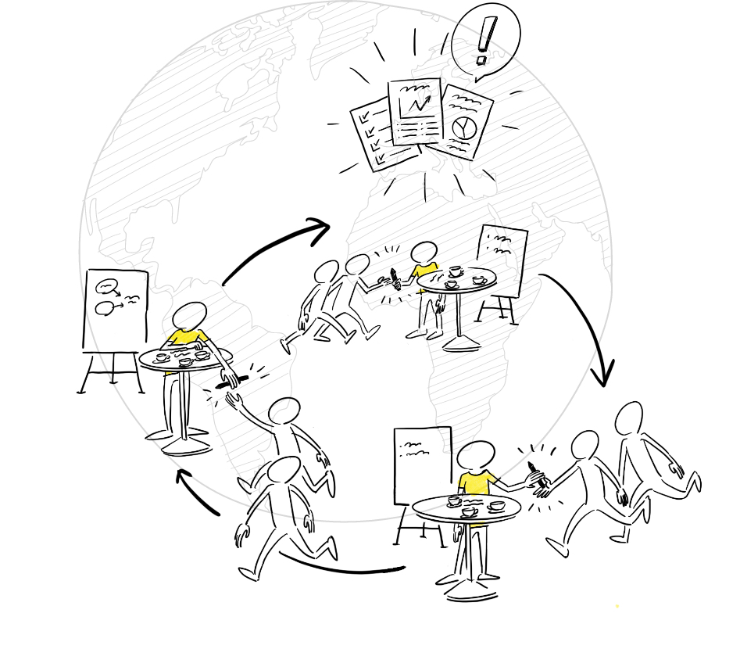
Instructions:
The facilitator should create a friendly and inclusive café atmosphere where participants feel comfortable developing new eco-entrepreneurship ideas.
The room has to be equipped by 4 tables, normally seating 5 persons (host + 4 guests).
Facilitator has to divide group into teams of five and give to groups, as topics, four different ecological issues for which participants have to find solution in the frame of eco-entrepreneurship ideas.
Facilitator should give inputs to participants about contents of presentation – short introduction, overview of the situation, the idea and how it is realized, highlighting the main benefits and conclusion.
Facilitator has to asks for volunteers, one per table, to be table hosts who have to present team’s eco-entrepreneurship idea to the rest of participants, so called “guests”.
After 30 minutes of discussions and developing eco-entrepreneurship ideas among team members, guests i.e. each team members excluding hosts, have to move from table to table as a group at regular intervals of 10 minutes, listen host’s 3minute presentation of eco-entrepreneurship idea, ask questions and give recommendations.
Table host has to ensure that everyone participates equally, take notes from conversation, greet newcomers and for every new of 4 rounds, expand own presentation by previous guests' key findings on presented eco-entrepreneurship idea.
After the table discussions, the hosts have 10 minutes in total to summarize outcomes. The facilitator then would explain what would happen to the results, including grouping of ideas and insights, and deeper analysis.
Results can be preserved by photographing drawings and texts.

Slide 7

Feedback and reflection
Evaluate the activity with two adjectives:
one positive
and
one negative adjective.

Slide 8

Budget control
TOOL 3
Format: Teamwork activity
Time: 120 minutes
Number of Participants: Maximum 20 participants divided into teams of five
Goal of the Tool: The goal is to create a teamwork activity that aims to develop financial skills of participants which includes financial management and risk analysis strategies for a real or imaginary eco-entrepreneurship.
The activity objectives are:
  To understand the basics about budgeting – a plan for how to use a set amount of money, over a period of three months
  To understand how to use a (very) basic budget worksheet
  To prioritize planning for some spending over others (needs vs. wants)
  To begin using a budget worksheet to make plans for future spending, (beyond three months)
  To calculate spending percentages and compare them with their priorities
  To point out potential risks and ways of it’s overcoming
  To think about ways for providing enough income to cover expenses

Slide 9

Instructions:
The room has to be equipped by 4 tables, normally seating 5 persons
Facilitator has to divide group into teams of five and give to groups, as topics, four different types of eco-entrepreneurship
Facilitator should provide to each team a budget worksheet in MS Excel where participants would fill information about expenses for each key activity or task of their given enterprise, including expected incomes and potential investments, for the period of next 3 months
Each team should Each team should discuss, research, calculate and present the information from a budget spreadsheet in MS Excel in such a way that will allow them to answer these questions:
  What resources do you need to maintain your eco-enterprise?
  What is the total cost of each key activity for the enterprise?
  Which key activity represents a significant expense to the enterprise?
  Which type of expenses is the highest?
  What percentage of the total enterprise cost does each key activity represent?
  Which partners do you want to collaborate with to maintain your eco-enterprise?
  What is the expected income?
  How you plan to provide enough income to cover expenses?
  What are risks your enterprise could deal with and how to overcome it?
After 80 minutes of teamwork, each team should present their report to the group.

Slide 10

Feedback and reflection
What are the key takeaways from this activity?

